Slide 1
Turing Machine Lecture
Tim Greer
Chad Spensky

Slide 2
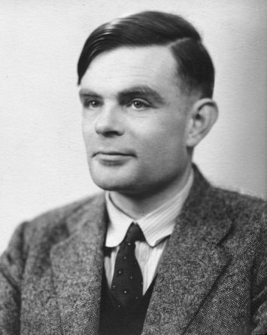
Who Was Turing?
Alan Turing (1912-1954)
Computer scientist, mathematician, logician, cryptanalyst, philosopher, mathematical biologist, and marathon runner
Two greatest achievements
Turing Test and Turing Machine
For more information, see “Alan Turing: The Enigma” or The Imitation Game

Slide 3
Turing Test
Alan turning hypothesized that some day computers would be indistinguishable from humans
If the computer can sufficiently fool a human, it has passed the “Turing Test”
Artificial Intelligence
https://www.youtube.com/watch?v=1uDa7jkIztw

Slide 4
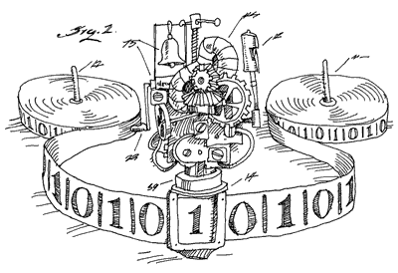
Intro to the Turing Machine
What is a computer?
What can computers understand?
How can we change what the computer does?
What does a Turing Machine have to do with any of this?

Slide 5


Turing Machine Concepts
Computers understand 1s and 0s (binary)
Everything a computer does is because it has processed 1s and 0s
Japanese philosophy
Computers can read and write
Quiz: how might a computer write a 4?

Slide 6
The Goal
https://www.youtube.com/watch?v=E3keLeMwfHY
Quiz: what does this mean we have really created?

Slide 7

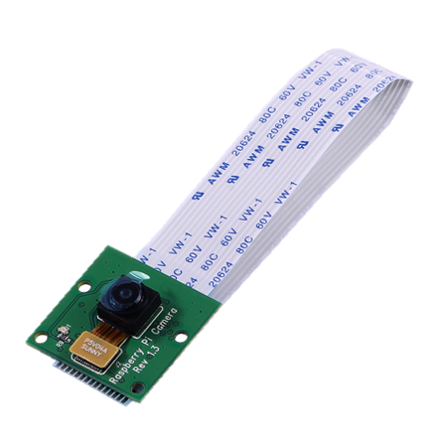
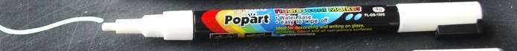
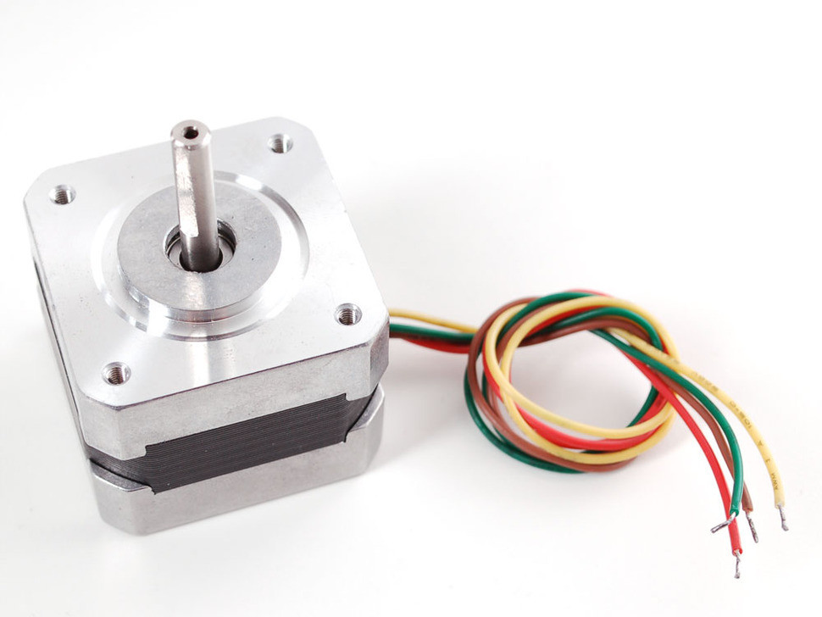
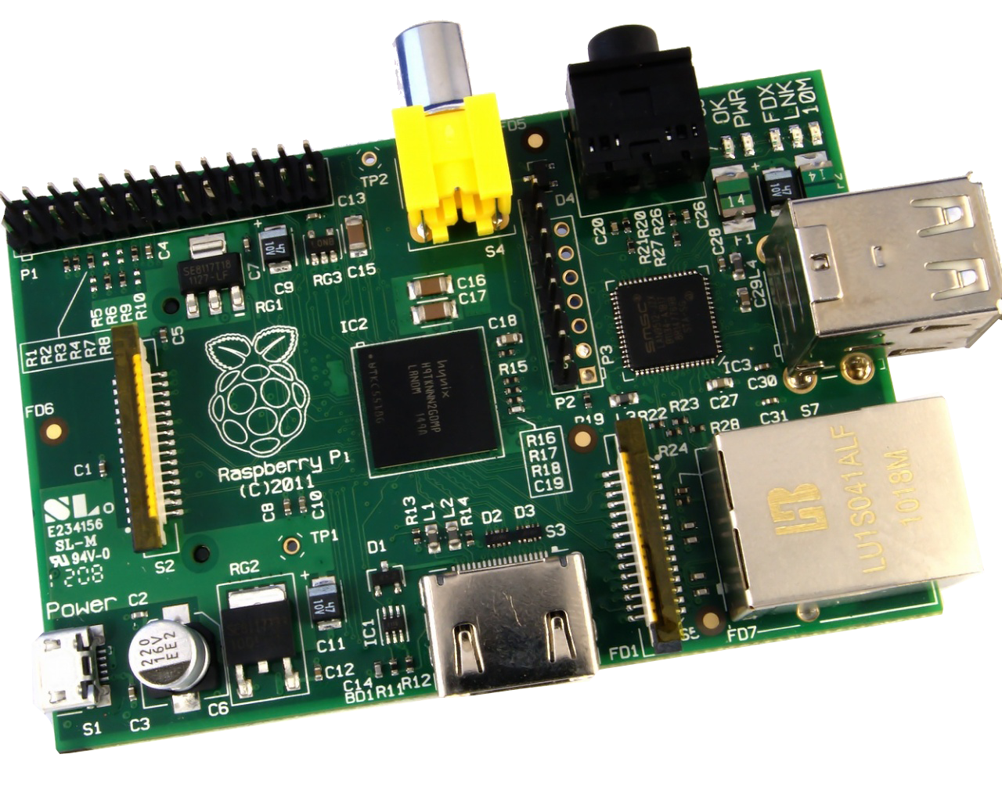
What are the components
A tape
A read head (To read the tape)
A write head (To write to the tape)
The ability to move the tape Left and Right
A brain

Slide 8
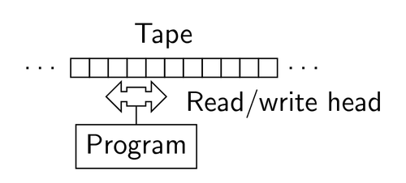
How does it work?

Slide 9
What is a Program?
A set of different states
Example: Start, State1, State2 End
Each state has a set of actions that depend on the tape value
Actions: Write, Erase, Move Left or Right
Each state also defines the next state to go to

Slide 10
Let’s do an Example
Let’s write all ones to the tape, forever!
States: Start, Write
Actions/Transitions:
Start: GOTO Write
Write: Erase, Write(1), Move L 1 step GOTO Write
Start
Write

Slide 11
Example 2
Let’s alternate 1’s and 0’s
States: Start, Write1, Write0
Actions/Transitions:
Start: GOTO Write1
Write1: Erase, Write(1), Move L 1 step GOTO Write0
Write0: Erase, Write(0), Move L 1 step GOTO Write1
Start
Write1
Write0

Slide 12
Example 3
Replace 1’s with 0’s and 0’s with 1’s
States: Start, Replace
Actions/Transitions:
Start: GOTO Write1
Replace: val = Read
If val == 1: Erase, Write(0), Move L 1 step GOTO Replace
If val == 0: Erase, Write(1), Move L 1 step GOTO Replace
Start
Replace

Slide 13

Your turn
To the white board!

